Slide 1

Semester End Examination (SEE) PRESENTATION
Abhinav Naikodi
393CS20001

Slide 2
CONTENTS
1. Company Description
2. On Job Training – 1
3. Use Case – 1
4. On Job Training – 2
5. Use Case – 2
6. Conclusion

Slide 3
1.Company description
OVERVIEW OF THE ORGANIZATION
TechifyIndia is a start-up for providing IT solutions, building innovative IoT products providing systems integration solutions and technology provider, established to provide leading edge intelligent technical solutions and consulting services to businesses
Since 2017, the company have been providing consulting service like:(website development, design services, IoT, application development and technical support) to clients in various industries

Slide 4
Vision and mission of the organization
To produce excellent services in the field of IT Services
The company's vision and mission is creating a positive impact on the industry and society
TECHIFYINDIA is one stop partner where you can outsource all your support services with complete peace of mind about quality and reliability.

Slide 5
Organization structure:
The executive team consists of 12 members, with the CEO being the highest-ranking member of the organization.
The organization's structure ensures that each department operates efficiently and effectively while working towards the company's goals.

Slide 6
Roles and Responsibilities of personnel in the organization
The roles and responsibilities of personnel within the organization vary depending on their job functions and departmental affiliations.
The common roles within the organization include CEO, Marketing management, Developers, H-R management, etc,

Slide 7
Products and market performance:
TECHIFYINDIA Software Solution’s strength lies in understanding the client’s business processes, culture, vision and goals across the industry segments and offering client oriented solutions which are highly reliable, creating customer comfort. Few of our products are listed below.
Cashew Soft ERP
TAX-E(GST Billing)
CNC Monitoring
IOT Based Smart Bell, etc

Slide 8
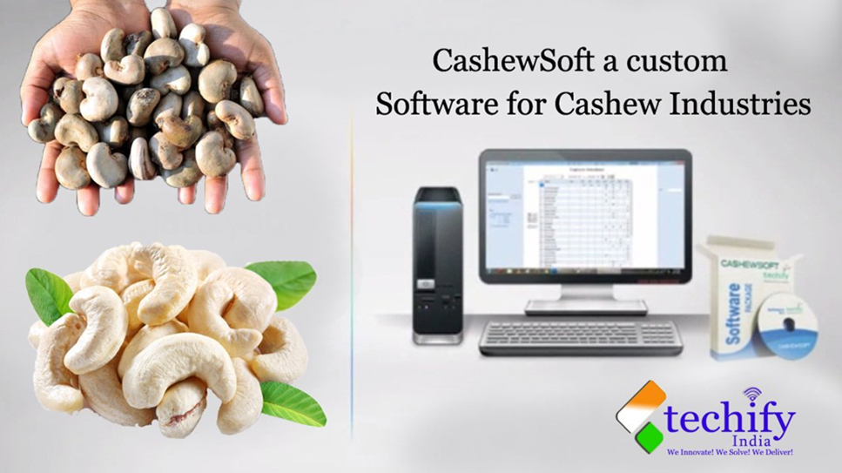


Slide 12
2. ON JOB TRAINING - 1
PYTHON PROGRAMMING WITH OOP’s
Python is an high-level, interpreted programming language that emphasize code readability and simplicity.
Python is known for its elegant syntax and easy-to-understand code, making it a popular choice for beginners and experienced developers.
It supports various programming paradigms, including procedural, functional, and object – oriented programming (OOP)
Python programming with an emphasis on OOP principles, concepts, and implementation.

Slide 13
OBJECT ORIENTED PROGRAMMING (OOP)
Object oriented programming is a programming paradigm that provide a structure way to design and build software.
Classes and object : In oop, a class representation a real-world entity. It defines the structure and behavior that objects of that class will possess. Object is an instance of class representing a specific entity
Encapsulation : encapsulation is a function principle of oop that combines data function into a single unit called a class.
Inheritance : inheritance is a mechanism that allows a class to inherit attribute and method from another class, called the base class or parent class.
Polymorphism: polymorphism is the ability of object of different classes to be treated as object of a common base class.

Slide 14
IMPLEMENTATION OF OOP IN PYTHON
Classes: Define classes to encapsulate data and behavior.
Objects: Create objects (instances) of classes to represent specific instances of the data.
Inheritance: Use inheritance to create subclasses that inherit properties and methods from a parent class.
Polymorphism: Utilize polymorphism to create multiple methods with the same name but different implementations in different classes.
Encapsulation: Use encapsulation to hide the internal details of a class and provide public interfaces for interacting with the object.

Slide 15
BENEFITS OF OOP IN PYTHON
Code reusability
Encapsulation and data hiding
Abstraction and simplified complexity
Inheritance and code reuse
Polymorphism and flexibility

Slide 16
IMPORTANT FUNCTION OF PYTHON
Map: The map() function in Python is used to apply a given function to each item in an iterable
Filter: The filter() function in Python is used to filter out elements from an iterable based on a specified condition.
Reduce: The reduce() function is part of the functools module in Python. It is used to apply a specified function to the elements of an iterable in a cumulative way.
Lambda Functions: A lambda function is a small, anonymous function in Python. It is defined using the lambda keyword and can take any number of arguments but can only have one expression.

Slide 17
3.USE CASE - 1
Library Management Application
A library management system is a software tool that helps libraries organize and manage their resources efficiently.
User Interface:
User Registration: The system allows users, such as students, faculty, and staff, to register and obtain a unique identifier, such as a library card or username, to access library services.
Circulation Management:
The circulation module manages the borrowing and returning of library items. It tracks the availability of items, handles due dates, and generates reminders or penalties for late returns.

Slide 18
PROBLEM STATEMENT
Threshold the input image in the HSV colour space using predefined colour ranges for skin colour to accurately detect traffic lights.
Contour Extraction: Utilize contour detection techniques to identify the contours of the Face in the binary masks obtained from color thresholding.
Filtering and Size-based Selection: Filter out small and irrelevant contours based on their area, using a minimum contour area threshold, to eliminate noise and improve detection accuracy.
Bounding Box Visualization: Draw bounding rectangles around the detected Face contours and annotate them with the corresponding Face for visual representation and interpretation

Slide 19
AI IMPLEMENTATION
NLP is used to enable natural language interaction with the system, allowing users to input account numbers through an input function.
Decision-making is implemented using conditional statements to process and respond to user input.
Automation is achieved by automating banking operations like depositing, withdrawing, and checking account balances, reducing manual intervention.

Slide 20
4. ON JOB TRAINING - 11
ARTIFICIAL INTELLIGENCE
AI application include advanced web search, recommendation systems, understanding human speech, self driving cars, generative or creative tools, automated decision making, and competing at the highest level in strategic game system.
The various sub field of AI research are centered around particular goals and the use of particular tools.
The traditional goals of AI research include reasoning, knowledge representation, planning learning, natural language processing, perception, and ability to move and manipulate objects.

Slide 21
TYPES OF AI
Artificial narrow intelligence: AI designed to complete very specific actions unable to independently learn.
Artificial general intelligence: AI designed to learn, think and perform at similar levels to humans.
Artificial superintelligence: AI able to surpass the knowledge and capabilities of human.
Reactive machines: AI capable of responding to externals stimuli in real time, unable to build memory or store information for future.
Theory of mind: AI that can sense and respond to human emotions, plus perform the tasks of limited memory machines.

Slide 22
MACHINE LEARNING
Machine learning is a branch of artificial intelligence (AI) and computer science which focuses on the use of data and algorithms to imitate the way that humans learn, gradually improving its accuracy.
Machine learning is an important component of the growing field of data science.
These insights subsequently drive decision making within applications and businesses, ideally impacting key growth metrics.
Machine learning algorithms are typically created using frameworks that accelerate solution development, such as TensorFlow and PyTorch.

Slide 23
MACHINE LEARNING METHODS
Supervised machine learning: Supervised learning, also known as supervised machine learning, is defined by its use of labeled datasets to train algorithms to classify data or predict outcomes accurately.
Unsupervised machine learning: Unsupervised learning, also known as unsupervised machine learning, uses machine learning algorithm to analyze and cluster unlabeled datasets.
Reinforcement machine learning Reinforcement machine learning is a machine learning model that is similar to supervised learning, but the algorithm isn’t trained using sample data

Slide 24
OpenCV
OpenCV open source computer vision library is an open source computer vision and machine learning software library
OpenCV was built to provide a common infrastructure for computer vision application and to accelerate the use of machine perception in the commercial product.
OpenCV is an open-source software library for computer vision and machine learning.
The OpenCV full form is Open Source Computer Vision Library. It was created to provide a shared infrastructure for applications for computer vision and to speed up the use of machine perception in consumer products.

Slide 25
HAAR CASCADE DATASET
Haar cascade is an algorithm that can detect objects in images, irrespective of their scale in image and location.
This algorithm is not so complex and can run in real-time. We can train a haarcascade detector to detect various objects like cars, bikes, buildings, fruits, etc
The main concept behind the Haarcascade algorithm is to train a classifier to identify specific patterns or features in an image that correspond to the object of interest.

Slide 26
5.USE CASE-11
SMART CITY MISSION
National Smart Cities Mission is an urban renewal and retrofitting program by the Government of India with the mission to develop smart cities across the country, making them citizen friendly and sustainable
The Union Ministry of Urban Development is responsible for implementing the mission in collaboration with the state governments of the respective cities.
Smart Cities Mission envisions developing an area within the cities in the country as model areas based on an area development plan, which is expected to have a ruboff effect on other parts of the city, and nearby citoes and towns.
The Smart Cities Mission is an initiative by the Government of India to improve the lifestyle of citizens living in that particular city or town.

Slide 27
FEATURES OF SMART CITY MISSION OF INDIA
The mission promotes the use of mixed land according to its per-area usage plan. Therefore, this allows the state to have vast land for multi-purposes and make the bye-laws accordingly.
Providing housing choices to everyone is another major goal of the Smart City projects.
The mission is set to give the people relief from congestion. Smart City India will also ensure the security of the people, promote communication, and reduce smog at the same time.
Developing recreational spots like gardens, parks, open gyms, playgrounds, and more are other major goals of the mission.
Government-related services are gradually going digital to promote transparency and accountability in the system and the people.

Slide 28
PROBLEM STATEMENT
Threshold the input image in the HSV colour space using predefined colour ranges for skin colour to accurately detect Face.
Contour Extraction: Utilize contour detection techniques to identify the contours of the Face in the binary masks obtained from color thresholding.
Filtering and Size-based Selection: Filter out small and irrelevant contours based on their area, using a minimum contour area threshold, to eliminate noise and improve detection accuracy.
Bounding Box Visualization: Draw bounding rectangles around the detected Face contours and annotate them with the corresponding Face for visual representation and interpretation.

Slide 29
CONCLUSION
In company we trained about Python, OOP’s, Python implementation with OOP, Benefits of OOP in python, important function in python like lambda, map, reduce, filter in internship .
We were assigned with Library Management System using python programming language, where we used python oops, python function like map, reduce, lambda. Created an programming which accepts the input as Book Title and search Book’s in library
During the internship we learnt about Artificial Intelligence, types of AI, Machine learning, OpenCv, Haar cascade dataset. We learnt about OpenCV through which the system can detect through its camera like human, human face, moving object, etc.
Assigned with task which shows Face detection using OpenCV. Here we created a program that detect the Face.

Slide 30
Thank You

